Slide 1



March 7, 2019
3
Notes:
Appendix includes recent awards, please visit elements.epam.com for all 2016-2017 awards

Slide 2
IN PREVIOUS PART: MSBI.Dev.S19E10
---
topics:
- topicname: Using Tools to Analyze Query Performance
subtopics:
- subtopicname: Query Optimization Problems and the Query Optimizer
- subtopicname: SQL Server Extended Events, SQL Trace, and SQL Server Profiler
- subtopicname: Using SET Session Options and Analyzing Query Plans
- subtopicname: Using Dynamic Management Objects
- topicname: Implementing Indexes and Statistics
subtopics:
- subtopicname: Heap Tables
- subtopicname: Clustered Indexes
- subtopicname: Supporting Queries with Indexes
- topicname: Understanding Cursors, Sets, and Temporary Tables
subtopics:
- subtopicname: Cursors
- subtopicname: Temporary Tables
---
3
Notes:
Appendix includes recent awards, please visit elements.epam.com for all 2016-2017 awards

Slide 3
Agenda: MSBI.Dev.S19E12
---
topics:
- topicname: BI. Business Intelligence
subtopics:
- subtopicname: magic quadrant for business intelligence and analytics platforms
- subtopicname: MS BI Architecture
- subtopicname: Common BI solution architecture
- topicname: Data Warehouse
subtopics:
- subtopicname: Reporting Problems with a Normalized Schema
- subtopicname: Star schema
- subtopicname: Snowflake Schema
- subtopicname: Granularity Level
- subtopicname: Data Warehouse structure
keywords: ['staging area, data vault, operational data store, data mart, data warehouse']
- subtopicname: Data Lake
- subtopicname: Inmon and Kimball
3
Notes:
Appendix includes recent awards, please visit elements.epam.com for all 2016-2017 awards

Slide 4
Agenda: MSBI.Dev.S19E12
- topicname: Designing Dimensions
subtopics:
- subtopicname: Dimension Column Types
- subtopicname: Dimension Column Types
keywords: ['Conformed dimension, Junk dimension, Degenerate dimension, Role-playing dimension']
- subtopicname: Hierarchies
- subtopicname: Slowly Changing Dimensions
keywords: ['SCD Type 0, SCD Type I, SCD Type II, SCD Type III']
- topicname: Designing Fact Tables
subtopics:
- subtopicname: Fact Table Column Types
- subtopicname: Fact Table Types
keywords: ['Factless Fact Table, Transaction Fact Tables, Periodic Snapshot Fact Tables, Accumulating Snapshot Fact Tables']
- subtopicname: Additivity of Measures
keywords: ['Additive measures, Semi-Additive measures, Non-additive measures']
- subtopicname: Slowly Changing Dimensions
keywords: ['SCD Type 0, SCD Type I, SCD Type II, SCD Type III']
3
Notes:
Appendix includes recent awards, please visit elements.epam.com for all 2016-2017 awards

Slide 5
BI. Business Intelligence

Slide 6








Why BI? Business Intelligence. The Five Questions
What happened?
What is happening?
Why did it happen?
What will happen?
What do I want to happen?
Past
Present
Future
Data
ERP
CRM
SCM
3Pty
Black books

Slide 7
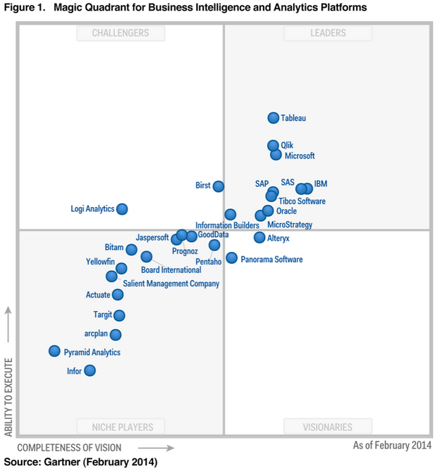
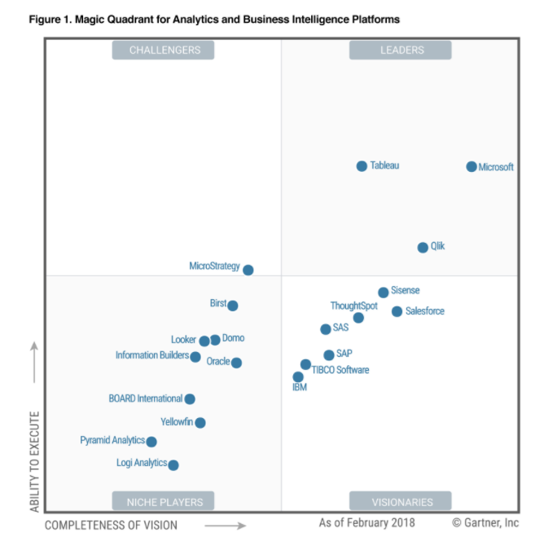
Business Intelligence.

Slide 8
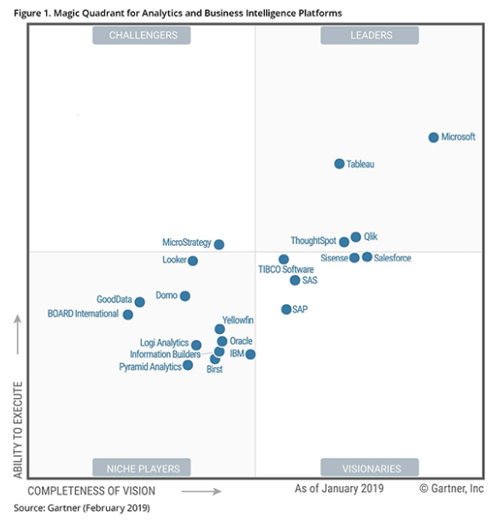
Business Intelligence.

Slide 9
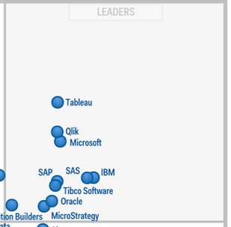
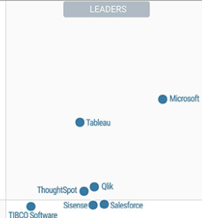
Business Intelligence.

Slide 10
MS BI Architecture

Slide 11
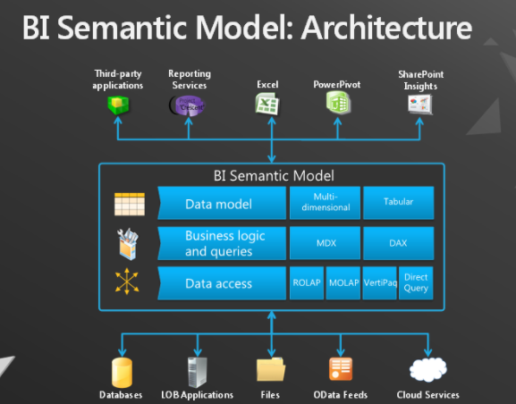
MS BI Architecture

Slide 12
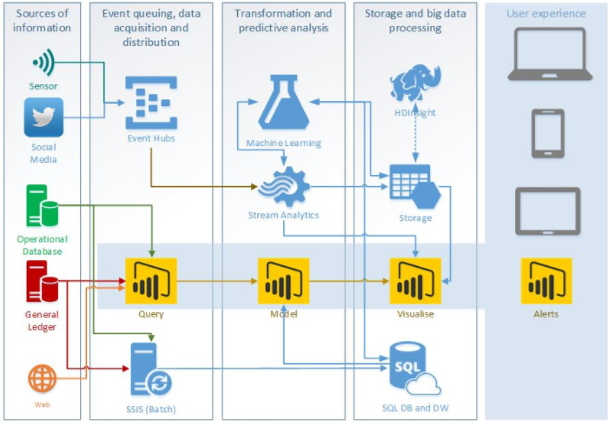
MS BI Architecture

Slide 13
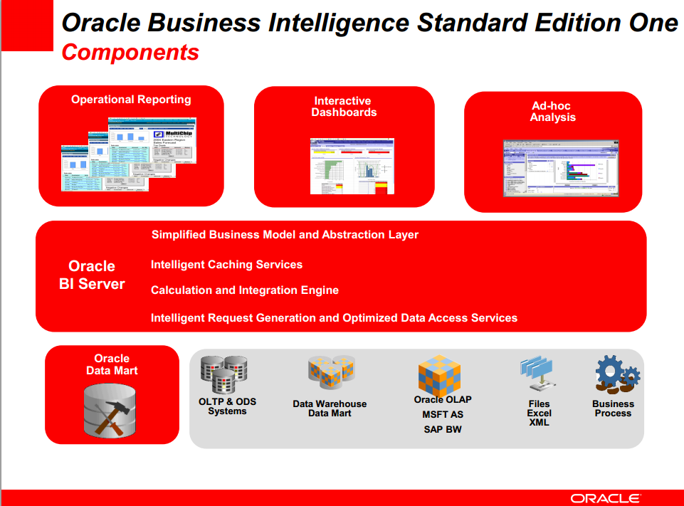
Oracle BI Architecture

Slide 14
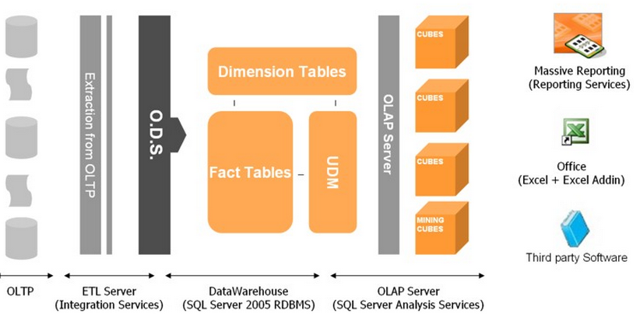
Common BI solution architecture

Slide 15
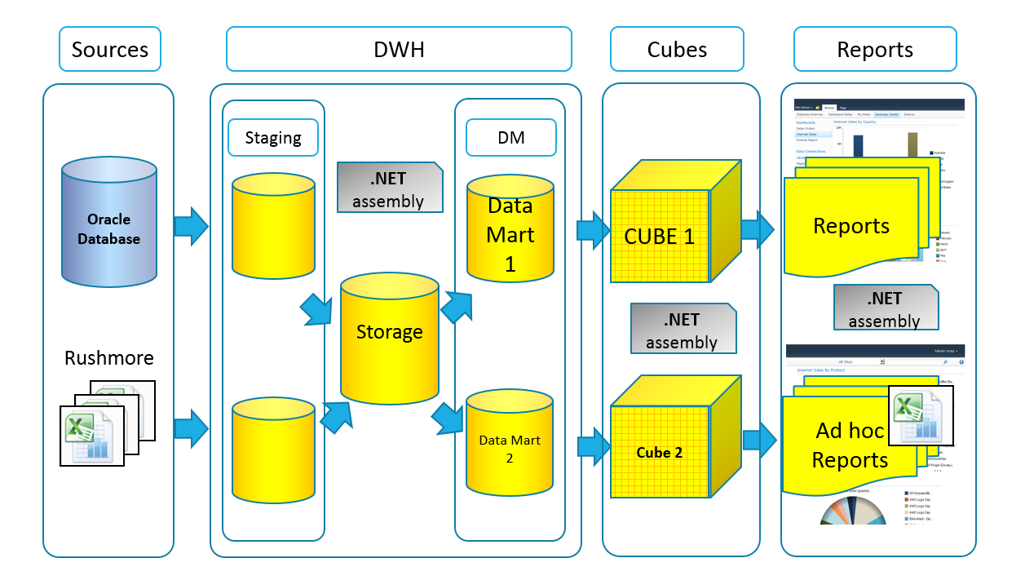
Common BI solution architecture

Slide 16
Designing and Implementing a Data Warehouse

Slide 17
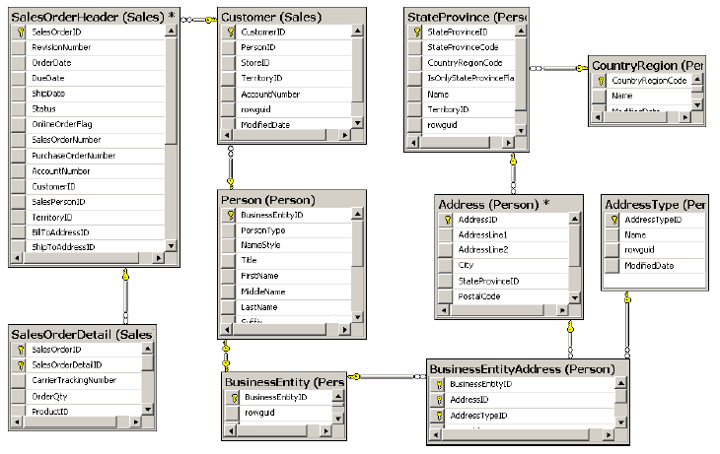
Reporting Problems with a Normalized Schema

Slide 18
Reporting Problems with a Normalized Schema
Comprehensive schema
Performance issues
Concurrency issues
LookUp table for Dates
Data Quality problem

Slide 19
Introducing Star and Snowflake Schemas
Introducing Star
and
Snowflake Schemas

Slide 20
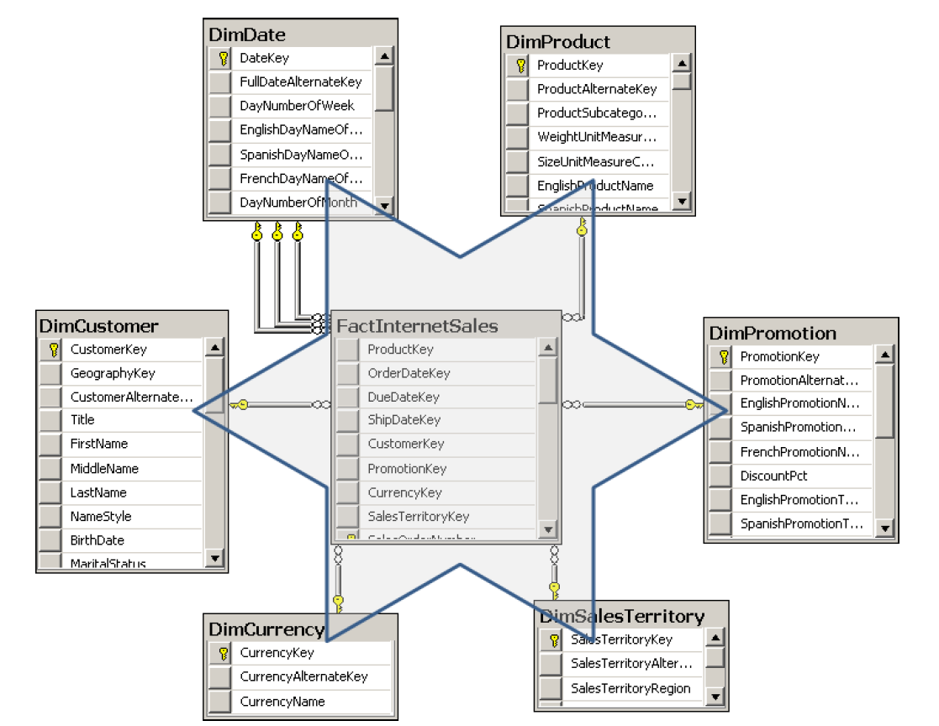
Star Schema
Dimension
Dimension
Dimension
Dimension
Fact Table
Dimension
Dimension

Slide 21
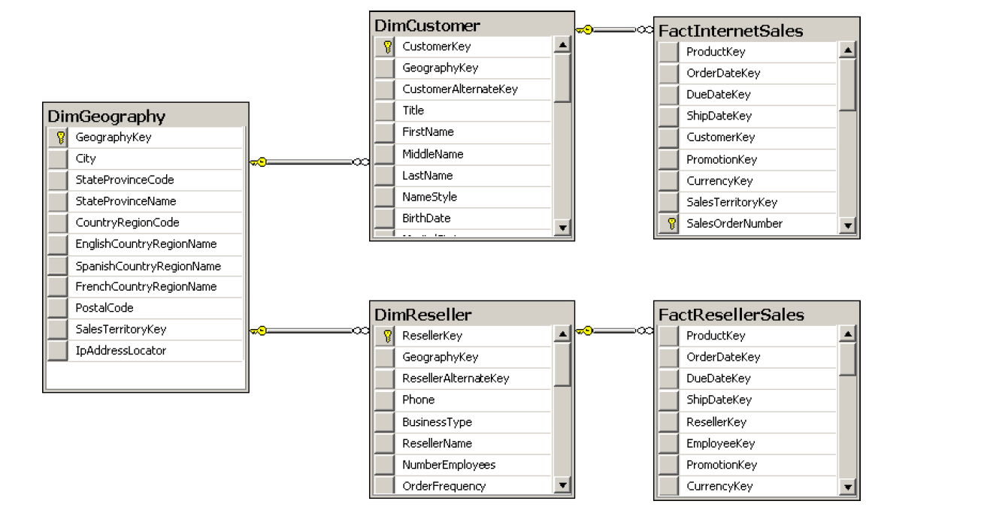
Snowflake Schema

Slide 22
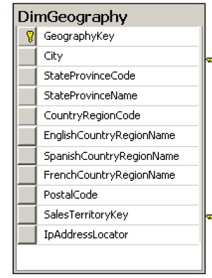
Snowflake Schema

Slide 23
Granularity Level
Notes:
Granularity Level
The number of dimensions connected with a fact table defines the level of granularity of
analysis you can get. For example, if no products dimension is connected to a sales fact table,
you cannot get a report at the product level—you could get a report for sales for all products
only. This kind of granularity is also called the dimensionality of a Star schema.
But there is another kind of granularity, which lets you know what level of information
a dimension foreign key represents in a fact table. Different fact tables can have different
granularity in a connection to the same dimension. This is very typical in budgeting and planning
scenarios. For example, you do not plan that customer A will come on date B to store C
and buy product D for amount E. Instead, you plan on a higher level—you might plan to sell
amount E of products C in quarter B in all stores in that region to all customers in that region.
Figure 1-7 shows an example of a fact table that uses a higher level of granularity than the
fact tables introduced so far.

Slide 24
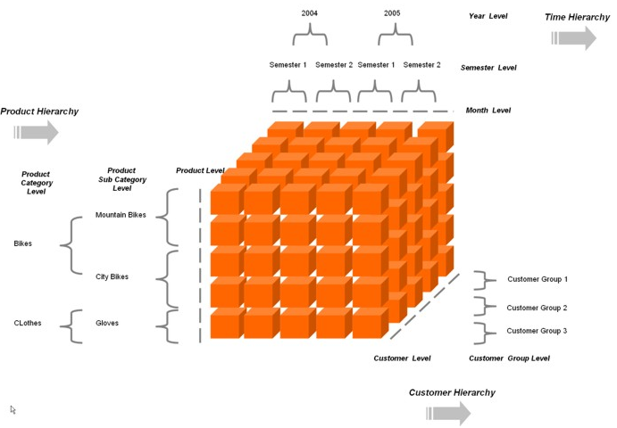
Star Schema – represent Multidimensional cube

Slide 25
Data Warehouse

Slide 26
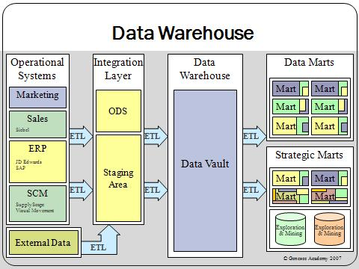
Data Warehouse

Slide 27
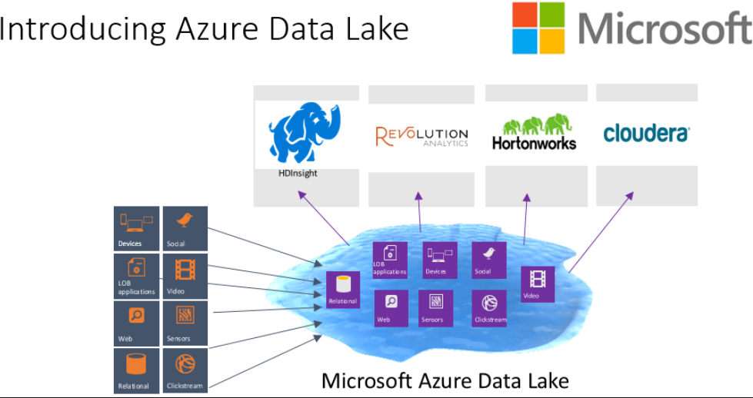
Data lake

Slide 28
Data lake

Slide 29
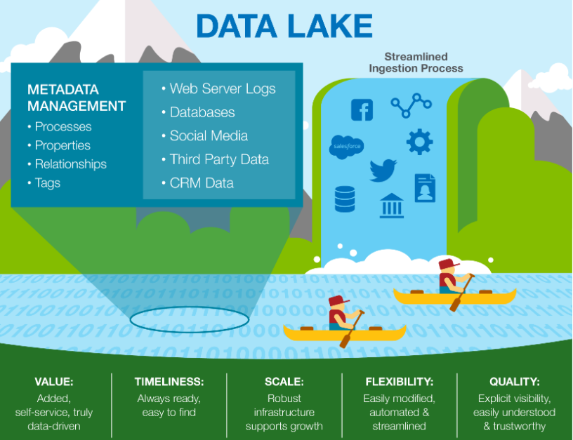
Data lake

Slide 30
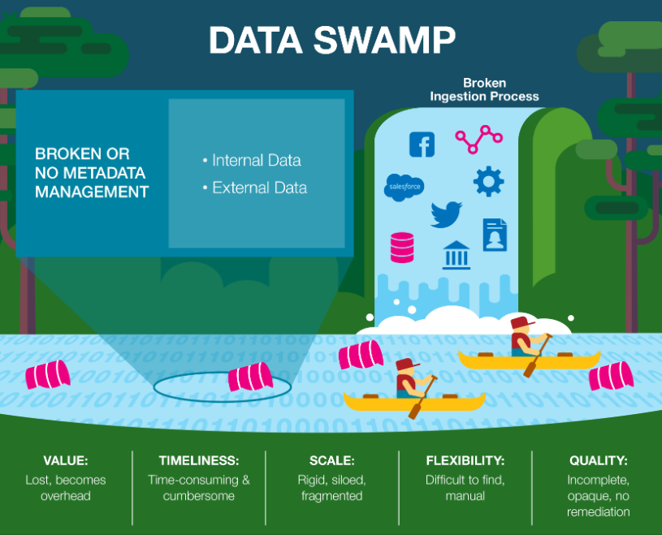
data swamp

Slide 31
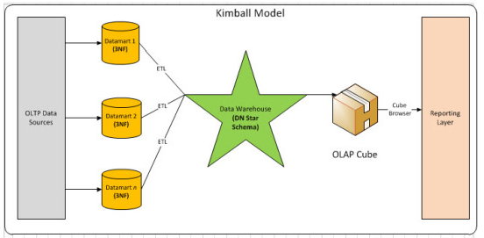
Data Warehouse – Kimball Model

Slide 32
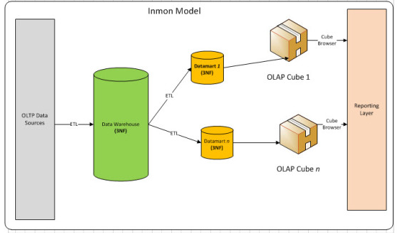
Data Warehouse – Inmon Model

Slide 33
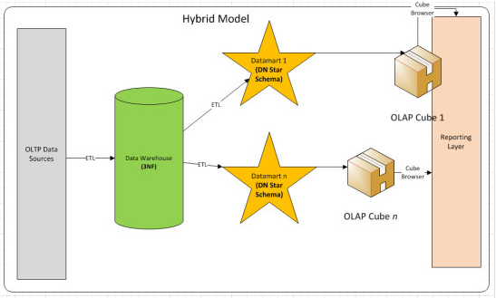
Data Warehouse – Hybrid Model

Slide 34
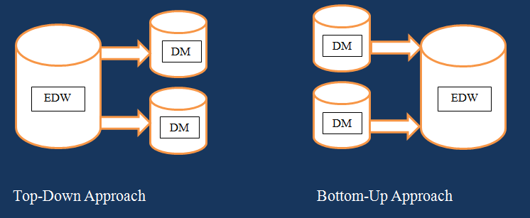
Data Warehouse
Inmon
Kimball

Slide 35
Designing Dimensions

Slide 36
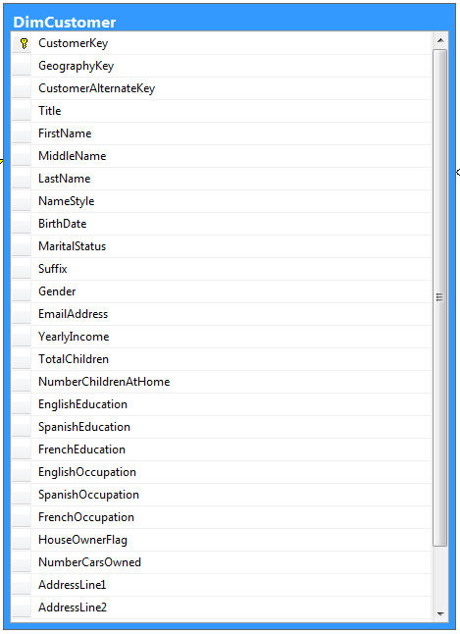
Dimension Column Types
Keys
Used to identify entities
Name columns
Used for human names of entities
Attributes
Used for pivoting in analyses
Member properties
Used for labels in a report
Lineage columns
Used for auditing, and never exposed to end users

Slide 37
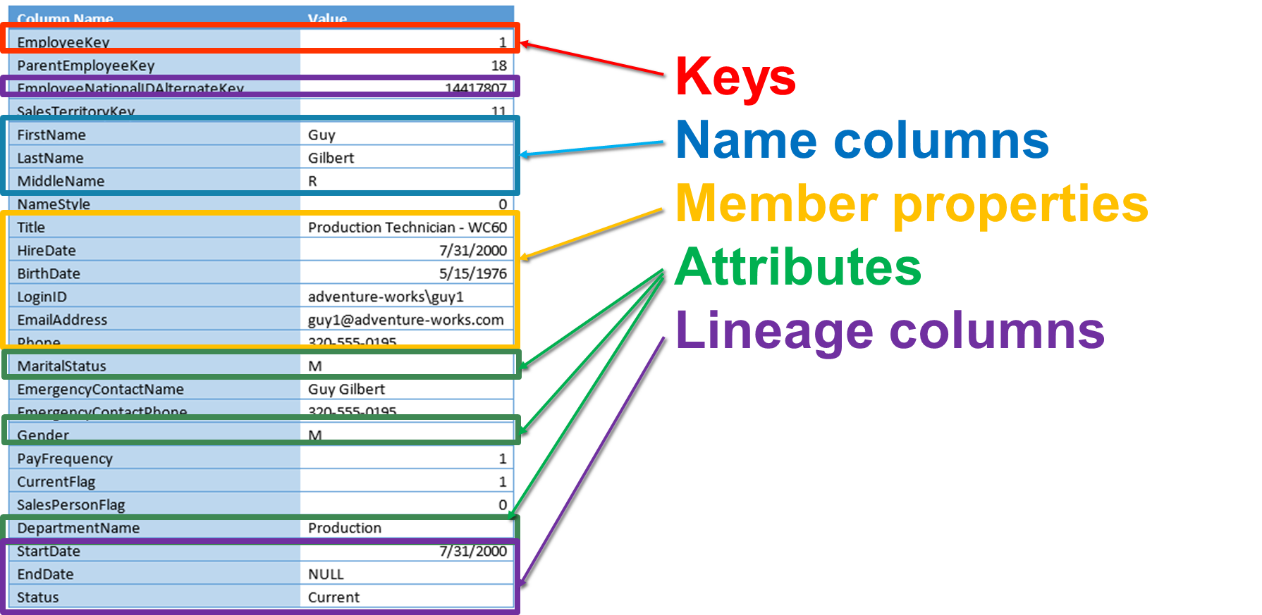
Dimension Column Types - DimEmployee

Slide 38
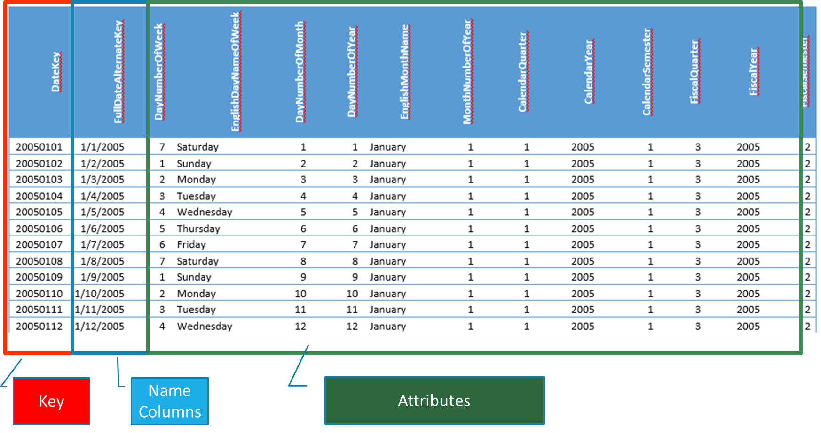
Dimension Column Types - DimDates

Slide 39
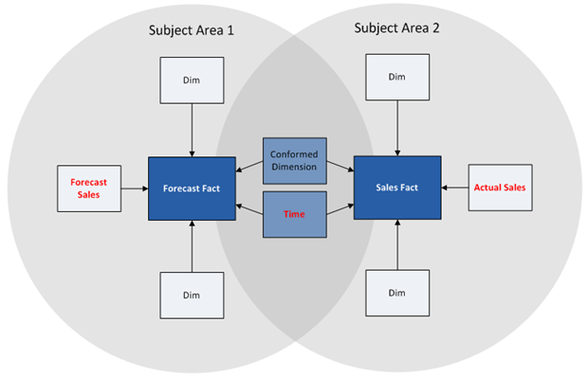
Dimension Types
Conformed dimension

Slide 40
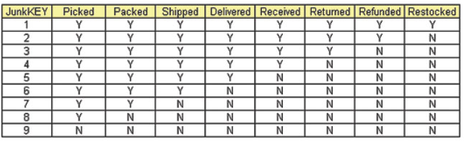
Dimension Types
Junk dimension

Slide 41
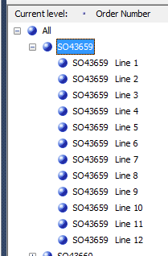
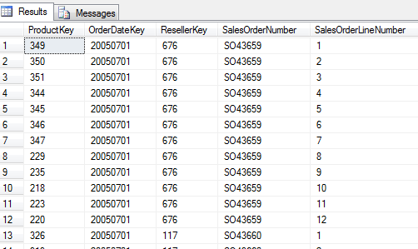
Dimension Types
Degenerate dimension

Slide 42
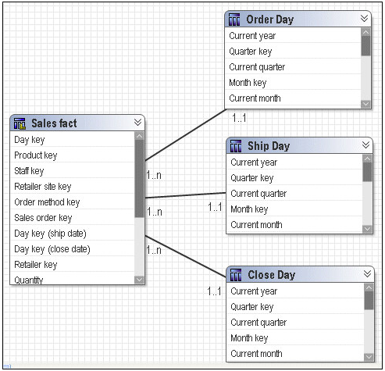
Dimension Types
Role-playing dimension

Slide 43
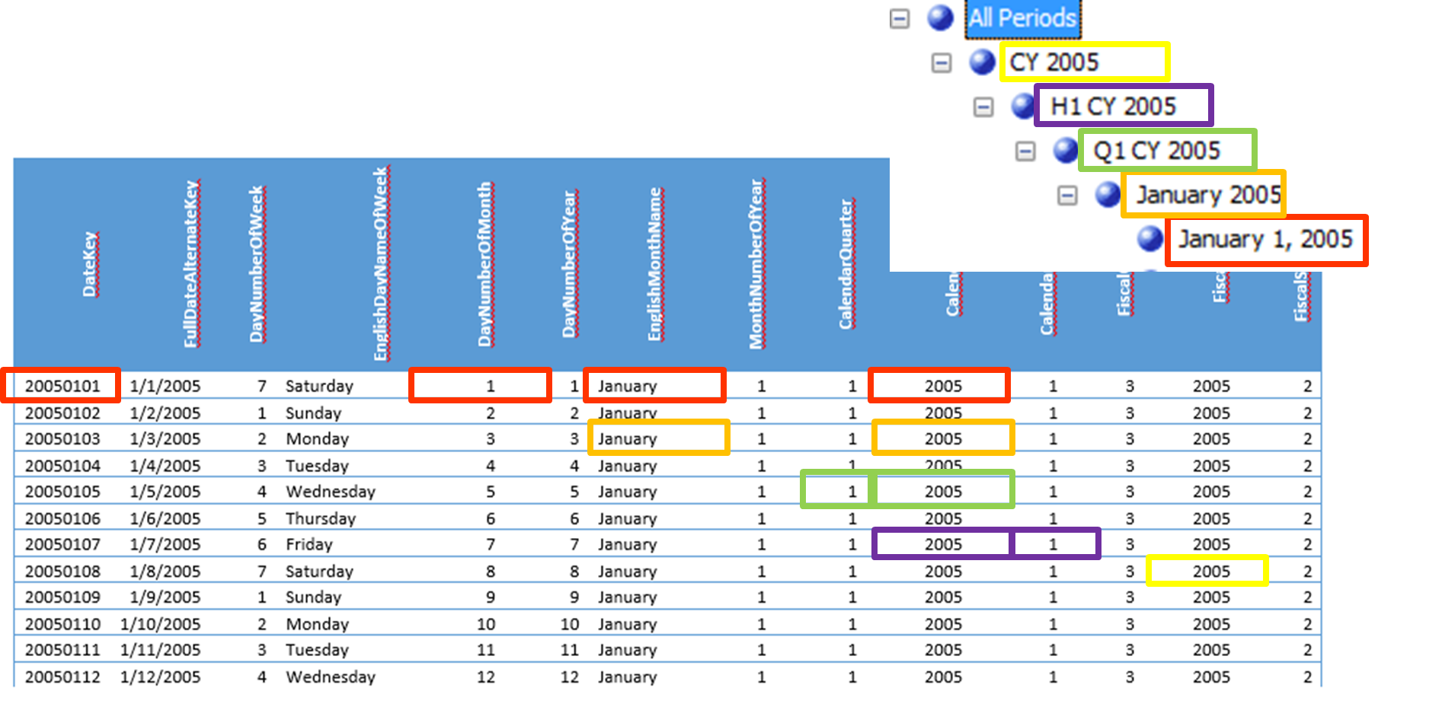
Hierarchies

Slide 44
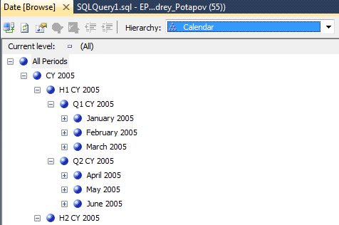
Hierarchies

Slide 45
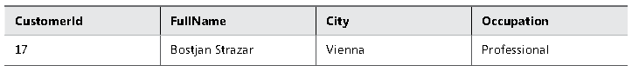
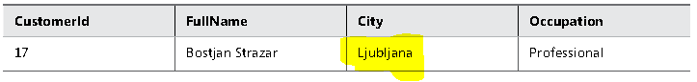
Slowly Changing Dimensions
SCD Type 1

Slide 46
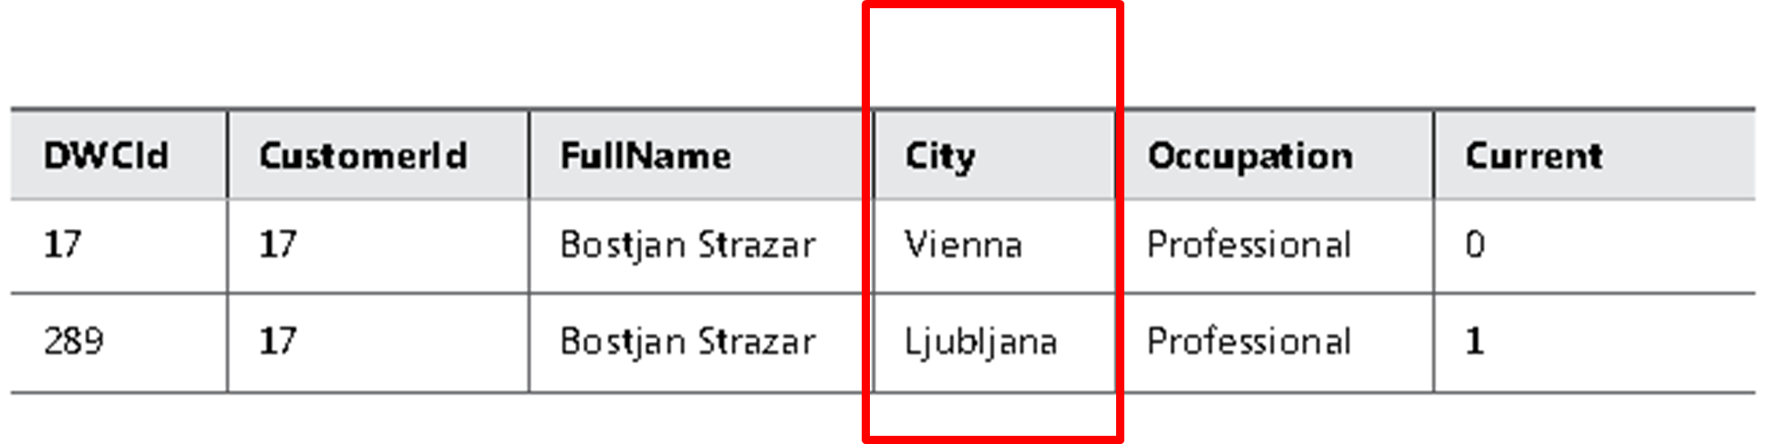
Slowly Changing Dimensions
SCD Type 2

Slide 47
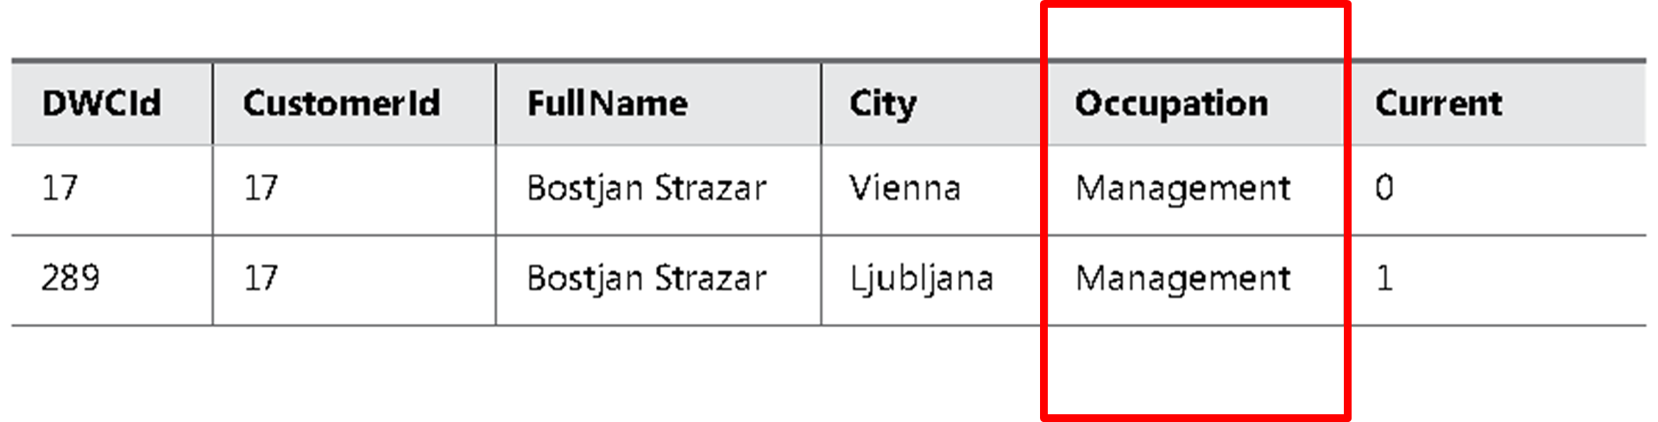
Slowly Changing Dimensions
An SCD Type 1 and Type 2 Mixture, Updating All Rows

Slide 48
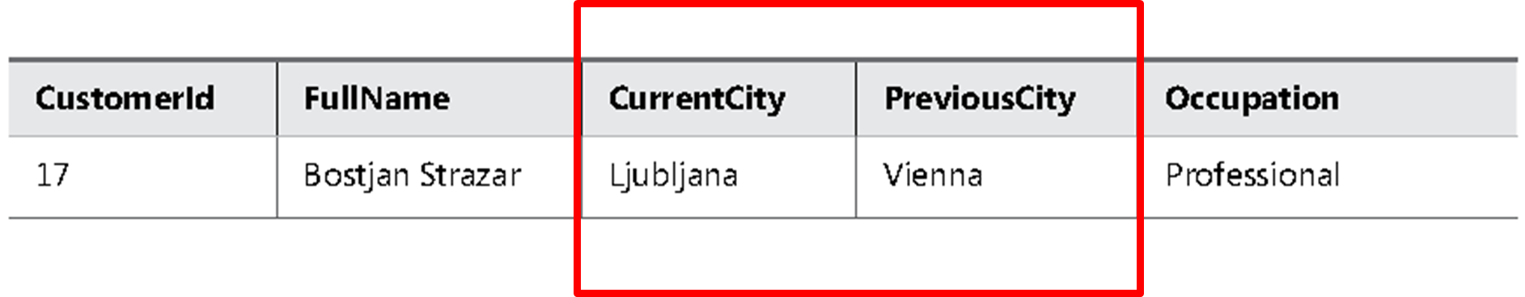
Slowly Changing Dimensions
SCD Type 3

Slide 49
Designing Fact Tables

Slide 50
Fact Table Column Types

Slide 51
Fact Table Column Types
Foreign keys
Measures
Lineage columns (optional)
Business key columns from the primary source table (optional)

Slide 52
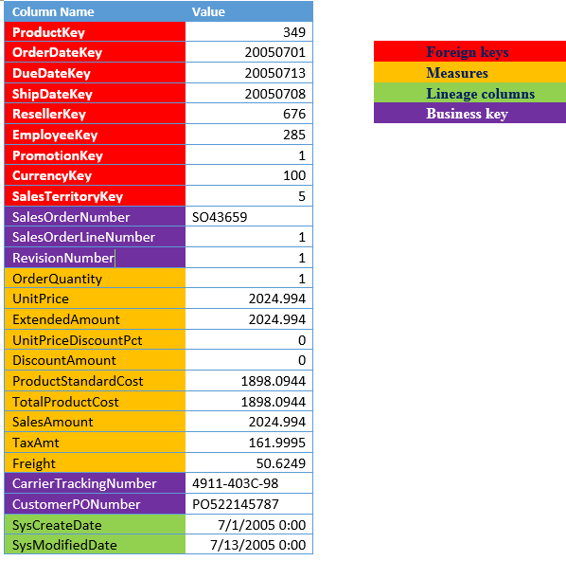
Fact Table Column Types
FactResellerSales

Slide 53
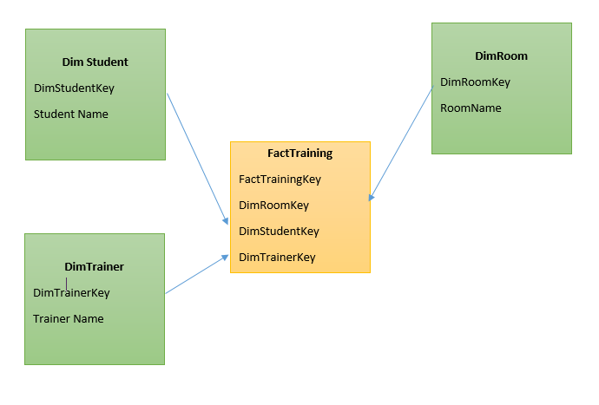
Fact Table Types
Factless Fact Table

Slide 54
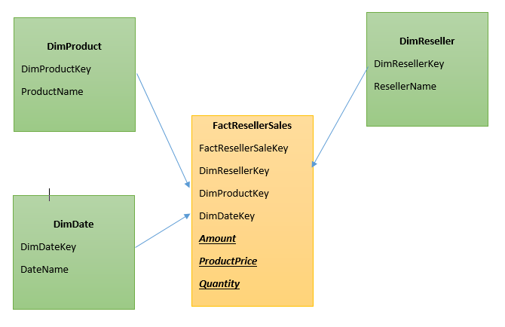
Fact Table Types
Transaction Fact Tables

Slide 55
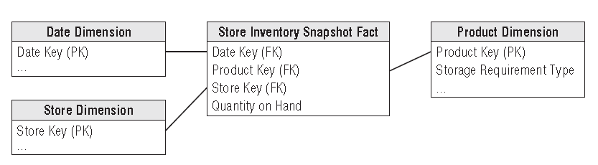
Fact Table Types
Periodic Snapshot Fact Tables

Slide 56
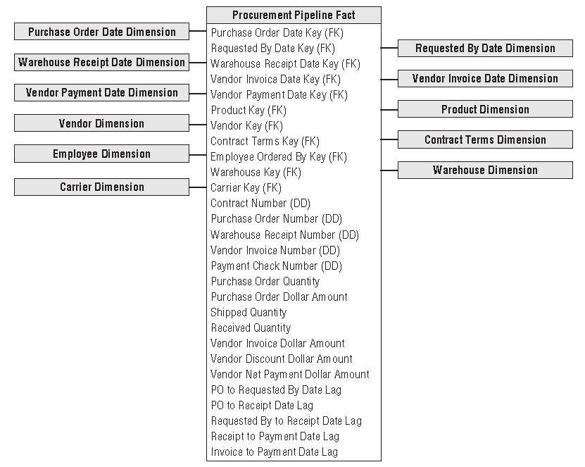
Fact Table Types
Accumulating
Snapshot Fact Tables

Slide 57
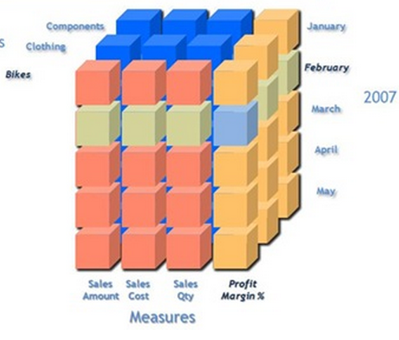
Additivity of Measures
Additive measures
Transaction amount
Semi-Additive measures
Account balance
Non-additive measures
Price
Notes:
Let us begin with the definition of each which will be followed by examples: 1. Additive measures: These are those specific class of fact measures which can be aggreagated across all dimension and their hieracchy 2. Semi-Additive measures: These are those specific class of fact measures which can be aggreagated across all dimension and their hieracchy except the time dimension 3. Non-additive measures: These are those specific class of fact measures which cannot be aggreagated across all/any dimension and their hieracchy
A good example of a non aggregatable measure might be 'Price' on a sales record. For example: A) We have sales figures...one may tend to add sales across all quareters to avail the yearly sales..hence this is an example of Additive measure B) We have stock levels say 1000(qty of Item A) on Monday...I sell 200(qty of Item A) on Tuesday I further sell 300(qty of Item A) on Wednesday...going by basic math On Thursday I should be left with 500(qty of Item A, assuming no inventory has flown in) to obtain current stock level I cannot aggregate the Stock sales across time dimension hierarchy...If done I will have inappropriate outcomes C) Aggregation of percentage or dates is an Ideal example of non-additive measures.
Additivity of measures is not exactly a data warehouse design problem. However, you should
consider which aggregate functions you will use in reports for which measures, and which aggregate
functions you will use when aggregating over which dimension.
The simplest types of measures are those that can be aggregated with the SUM aggregate
function across all dimensions, such as amounts or quantities. For example, if sales for product
A were $200.00 and sales for product B were $150.00, then the total of the sales was $350.00.
If yesterday’s sales were $100.00 and sales for the day before yesterday were $130.00, then
the total sales amounted to $230.00. Measures that can be summarized across all dimensions
are called additive measures.
Some measures are not additive over any dimension. Examples include prices and percentages,
such as a discount percentage. Typically, you use the AVERAGE aggregate function for
such measures, or you do not aggregate them at all. Such measures are called non-additive
measures. Often, you can sum additive measures and then calculate non-additive measures
from the additive aggregations. For example, you can calculate the sum of sales amount and
then divide that value by the sum of the order quantity to get the average price. On higher

Slide 58
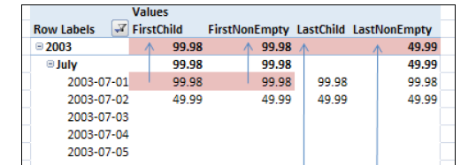
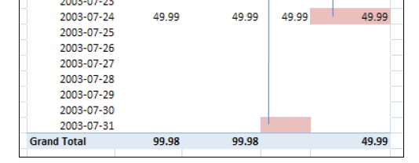
Additivity of Measures in SSAS
AverageOfChildren
FirstChild
LastChild
FirstNonEmpty
LastNonEmpty

Slide 59
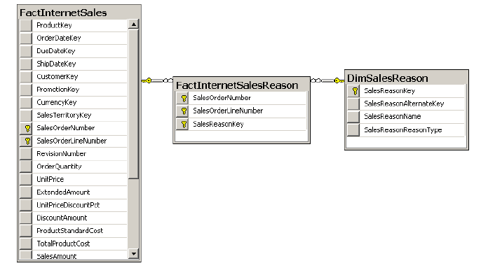
Many-to-Many Relationships
A classic many-to-many relationship

Slide 60
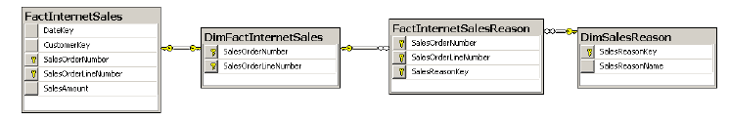
Many-to-Many Relationships
A many-to-many relationship with two intermediate tables

